Slide 1
I implement the following image processing feature in the project:
1. SIFT
2. Background Subtraction
3. Optical Flow tracking
3.1 Preprocessing
3.2 Tracking whole video
4. Face Recognition & Detection
4.1 Face Recognition
4.2 Face Detection
4.3 Face Detection + Recognition

Slide 2
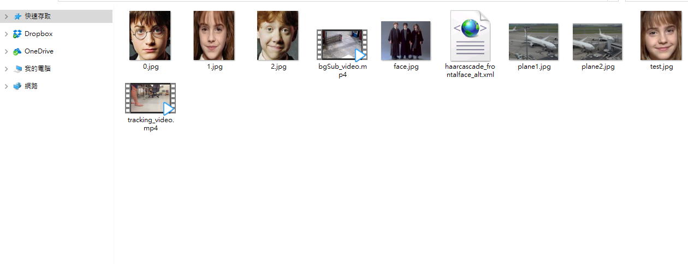
Image Resources
Folder “database”: includes image files plane1.jpg, plane2.jpg, 0.jpg, 1.jpg, 2.jpg, test.jpg, and face.jpg ; video files bgSub_video.mp4, tracking_video.mp4 ; xml file haarcascade_frontalface_alt.xml
Folder “database”

Slide 3
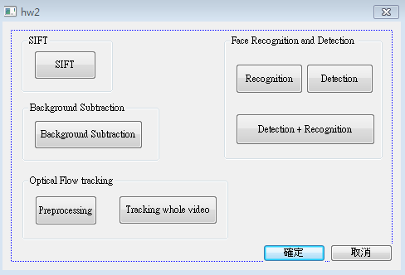
1.Display Format
I use Visual Studio MFC to create a window like this

Slide 4
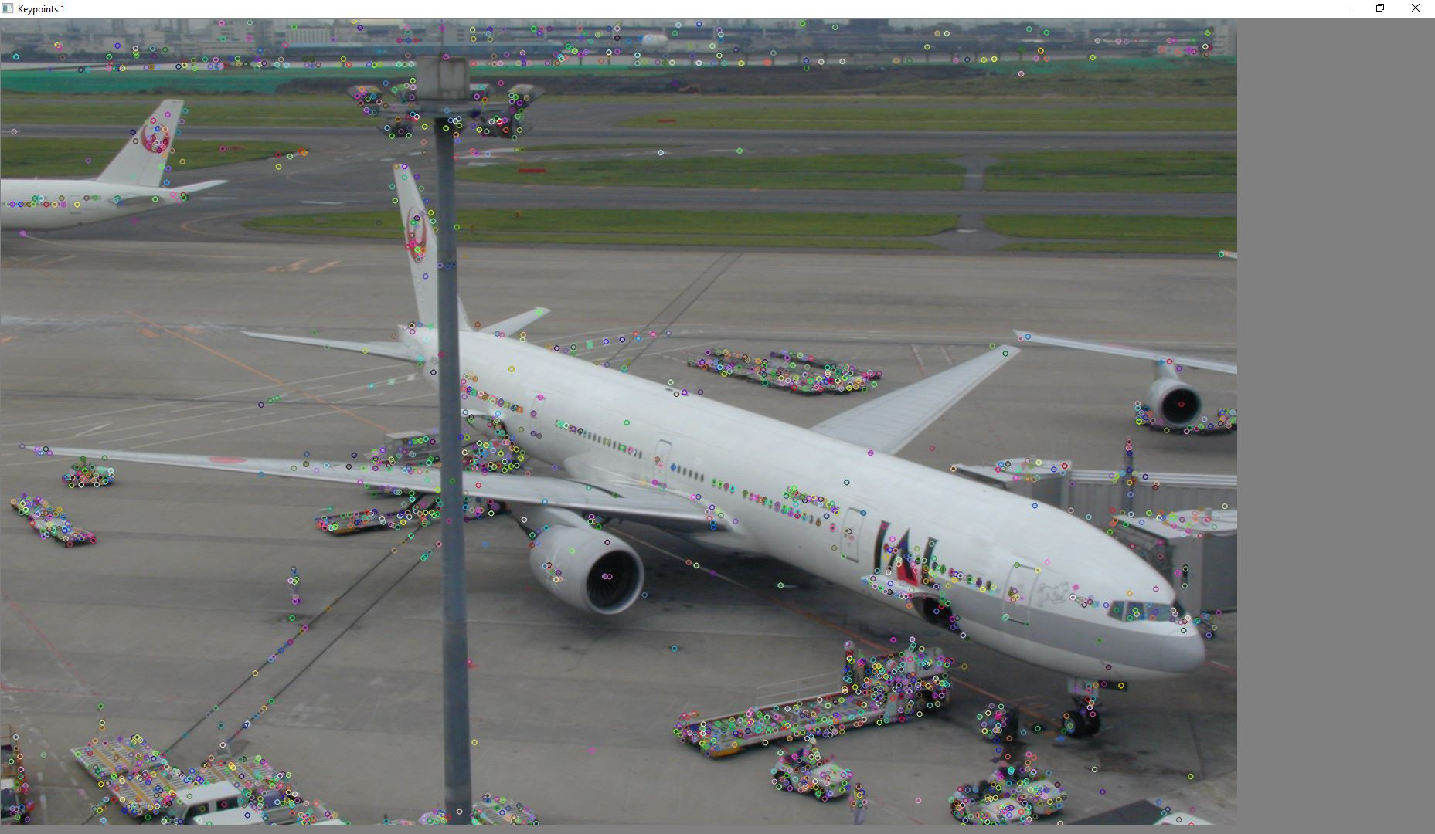
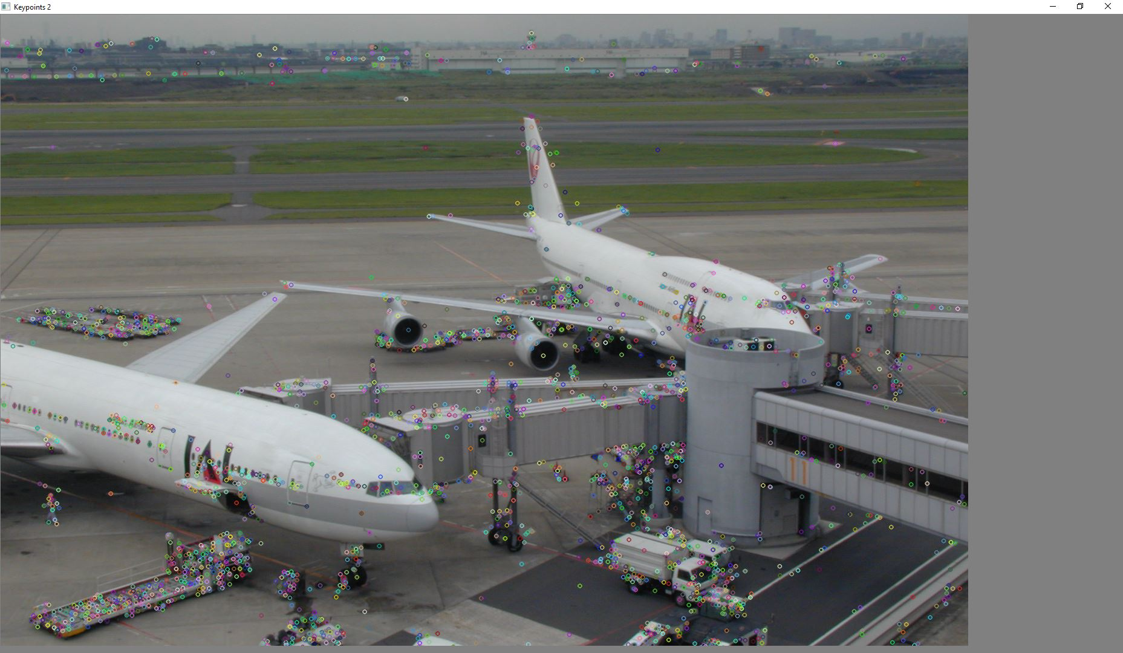
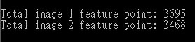
2. SIFT
Find feature points on the two images (plane1.jpg, plane2.jpg)
Draw every feature point on the two images and show the result
Output the number of feature points of each image on the console window
Hint: SiftFeatureDetector, drawKeypoints
示意圖:

Slide 5
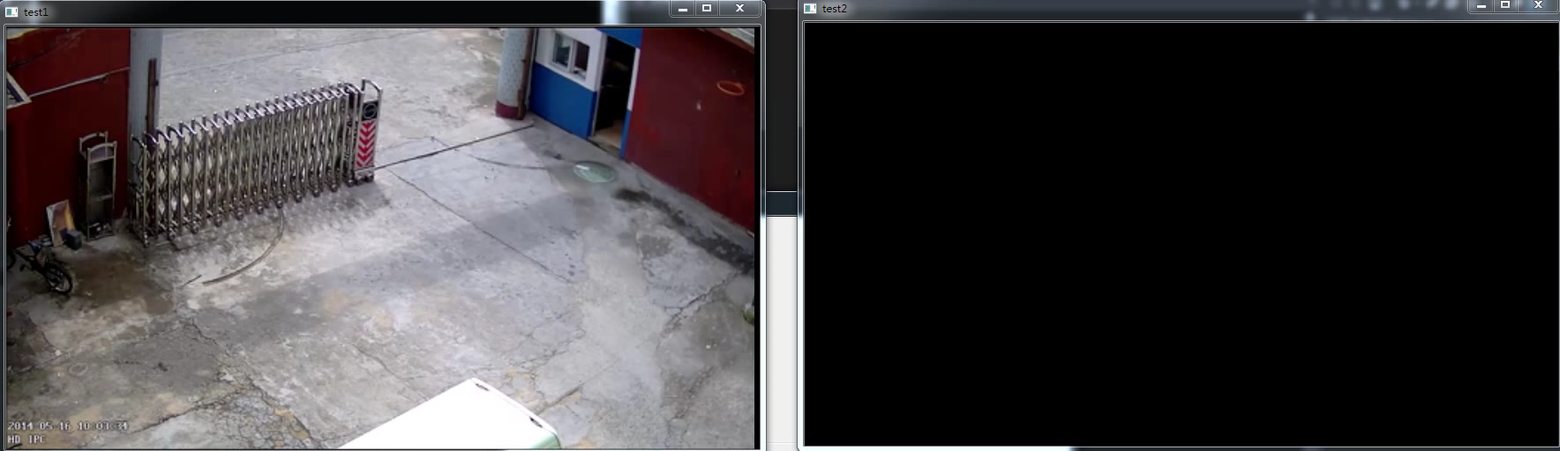
3. Background Subtraction
讀取影片 (bgSub_video.mp4)並提取出該影片的 foreground
1) 在兩個視窗分別播放原影片以及提取出 foreground 的影片
示意影片:

Slide 6
4. Optical Flow tracking
4.1 Preprocessing
4.2 Tracking whole video

Slide 7
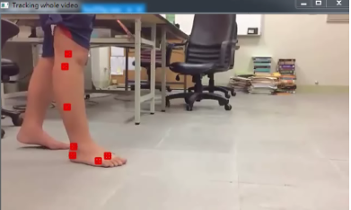
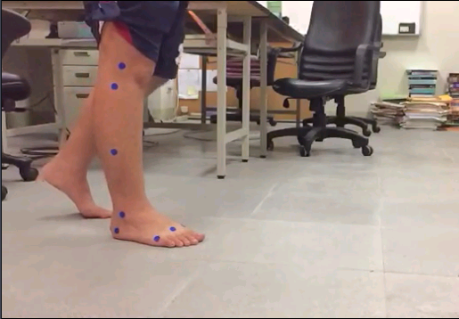
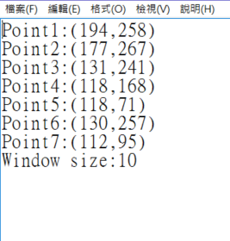

4.1 Preprocessing
讀取影片 (tracking_video.mp4) 並自行決定7個追蹤點的 initial position 和 window size
將7個追蹤點的 initial position 和 window size存在 (hw3_1.txt檔)
並在第一個frame上顯示出來
示意圖:
x
hw3_1.txt
(0,0)
window size
y

Slide 8
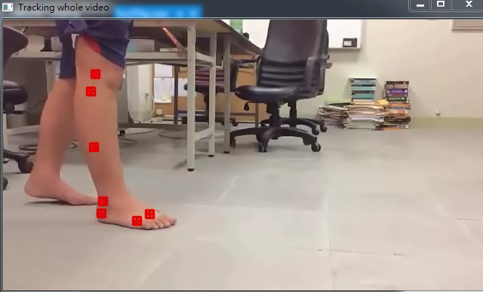
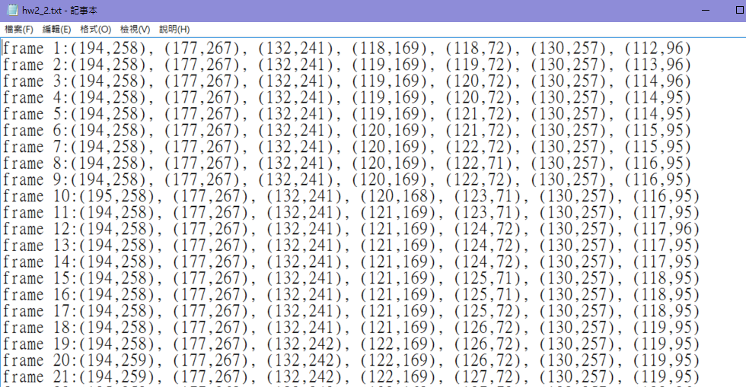
4.2 Tracking whole video
事先追蹤完整個影片的追蹤點，並將全部的點存在一個txt檔(hw3_2.txt檔)，然後讀取 (hw3_2.txt檔) ，並將那些點畫在原影片上，並連成一個軌跡圖
hw3_2.txt
示意影片:
※追蹤過程中可能會追蹤失敗，需要重新校正，可在某些frame手動調整點的位置，再重新追蹤

Slide 9
5. Face Recognition & Detection
5.1 Face Recognition
5.2 Face Detection
5.3 Face Detection + Recognition

Slide 10

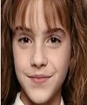

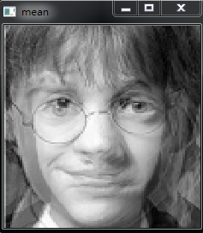
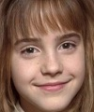
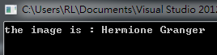
5.1 Face Recognition
training data: (100*120)
0.jpg
1.jpg
2.jpg
Harry Potter
Hermione Granger
Ron Weasley
Given three face images (0.jpg ~ 2.jpg), use eigenface to recognize the faces
1) Show the result of the mean face
2) Given a test image (test.jpg), show the name of the person on the console
window
Hint: class FaceRecognizer
Output format:
test data:
(100*120)
test.jpg
Hermione Granger

Slide 11
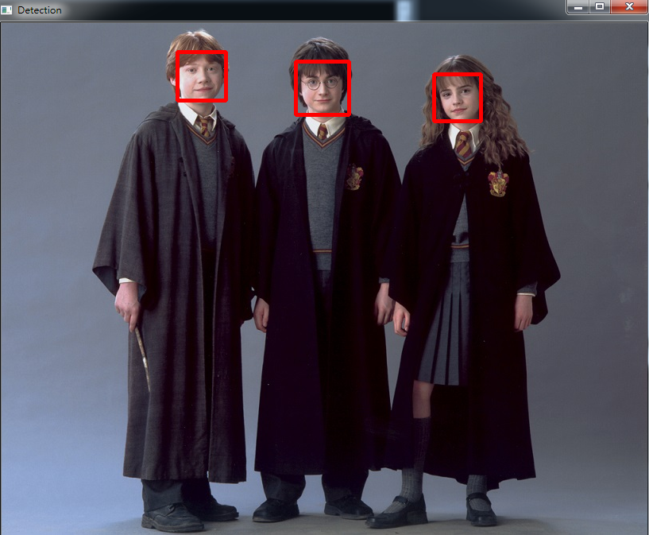
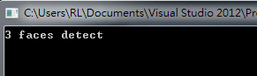
5.2 Face Detection
Given a image (face.jpg), detect the faces on the image by using Adaboost
1) Output the number of faces detected on the console window
2) Draw a rectangle on each face, and show the result
Hint: class CascadeClassifier
Output format:

Slide 12
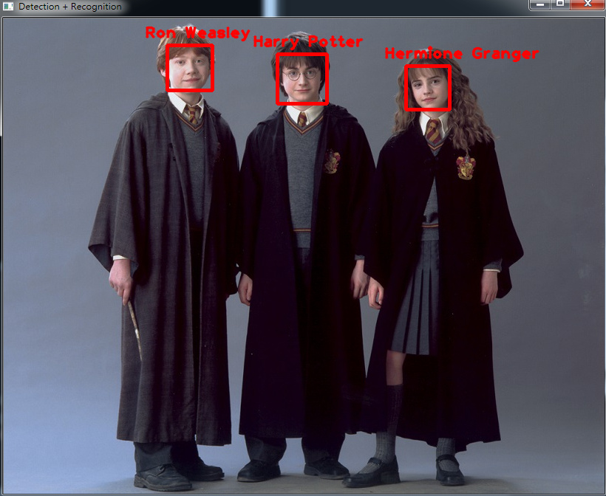
5.3 Face Detection + Recognition
Use the result of detected faces in 5.2, and recognize them.
1) Show the name of each person.
Output format:

